Slide 1
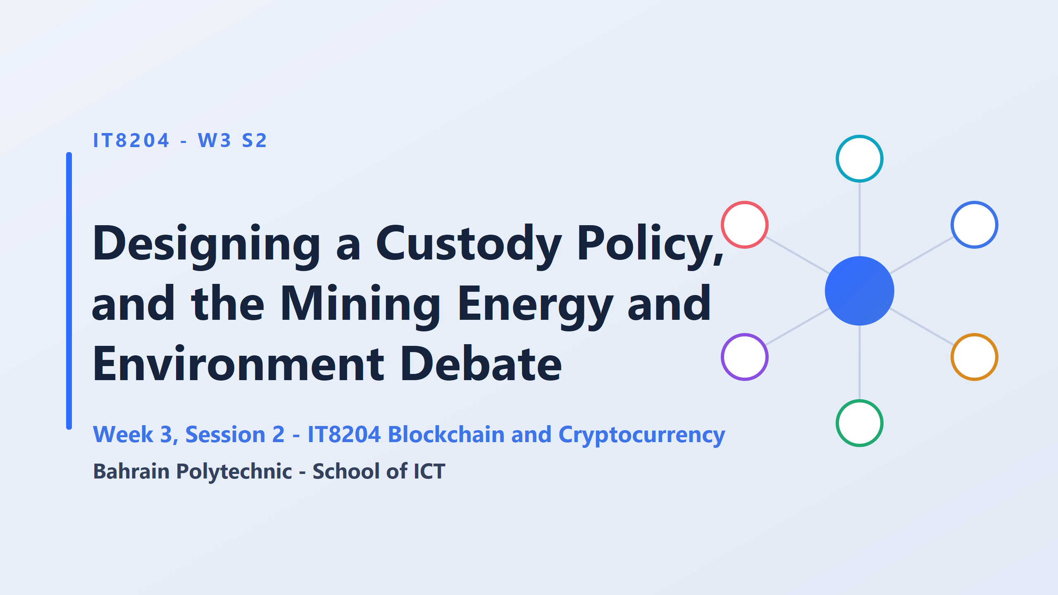
deciding how a company will safely store its crypto

Slide 2
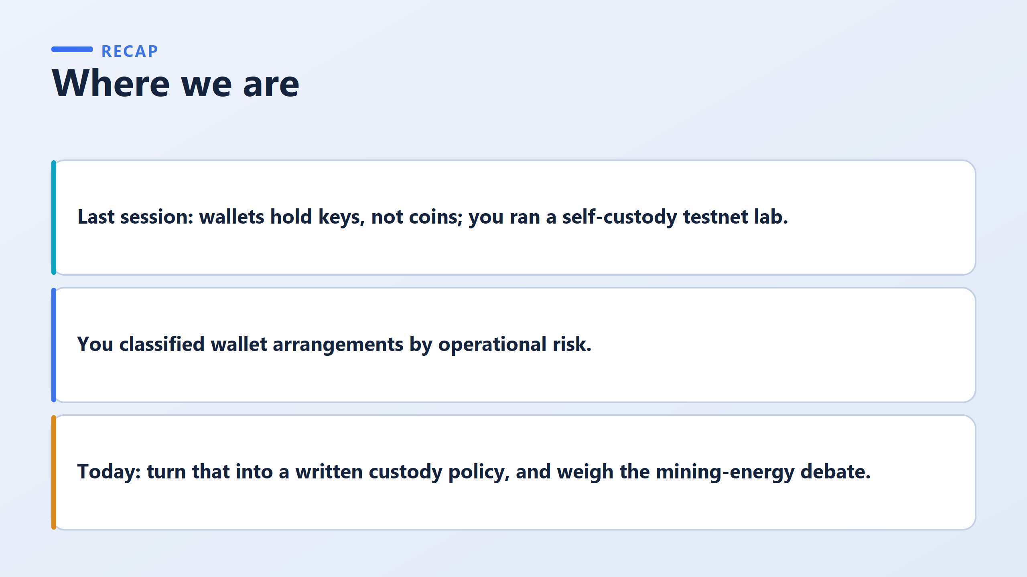

Slide 3
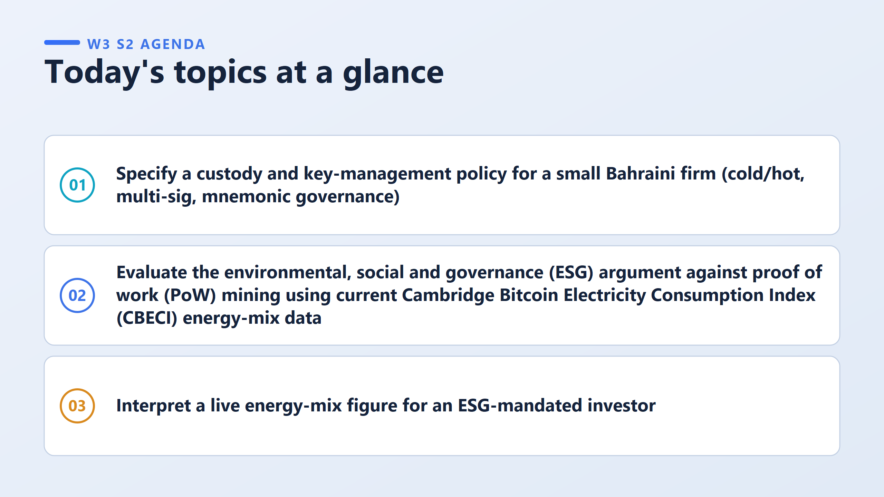
1) Cold/hot: how much crypto is kept offline (safe but slow) and how much online (fast but riskier)
Multi-sig: several people must approve a payment, not just one
Mnemonic governance: who looks after the secret backup words (the seed phrase), and where they are kept
2) test that claim using real data from the CBECI, a Cambridge University website that publishes how much electricity Bitcoin uses and what kind of energy it comes from
Two factories each use the same electricity. One runs on solar, the other on coal. Which one is worse for the environment, and how do you know from the total alone?" The answer is that you cannot know from the total. You need the mix.

Slide 4
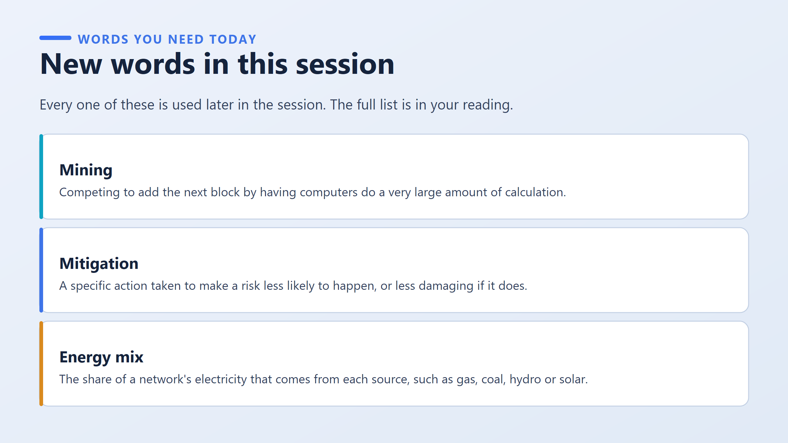
The energy mix is where the electricity comes from. Two networks can use the same amount of power but be very different for the environment. For example:
Network A uses 100 units, mostly from coal.
Network B uses 100 units, mostly from hydro and solar.
Same total, very different impact. So remember this:
The total tells you how much. The mix tells you how bad.
An investor with an environmental mandate (an ESG-mandated investor) is asking the second question, not the first. They care about how bad, so the mix matters more to them than the total.
Two of three keys must approve any transfer above 1,000 dollars, and the third key is kept in a bank safe-deposit box

Slide 5
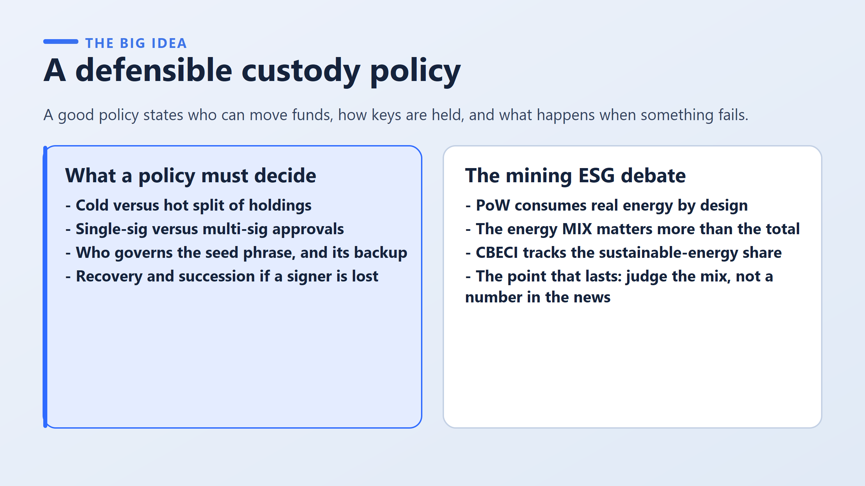
Cold versus hot split of holdings: how much crypto is kept offline (safe but slow) and how much is kept on a connected device (fast but riskier).
Single-sig versus multi-sig approvals: whether one person can approve a transfer alone, or several people must agree.
Who governs the seed phrase, and its backup: who protects the secret backup words, and where the copy is kept.
Recovery and succession if a signer is lost: what happens if someone who holds a key leaves, dies, or loses their device
PoW consumes real energy by design: the electricity use is part of how Bitcoin works.
The energy MIX matters more than the total: where the electricity comes from matters more than how much.
CBECI tracks the sustainable-energy share: the Cambridge index measures how much of the electricity comes from sustainable sources.
The point that lasts: judge the mix, not a number in the news.

Slide 6
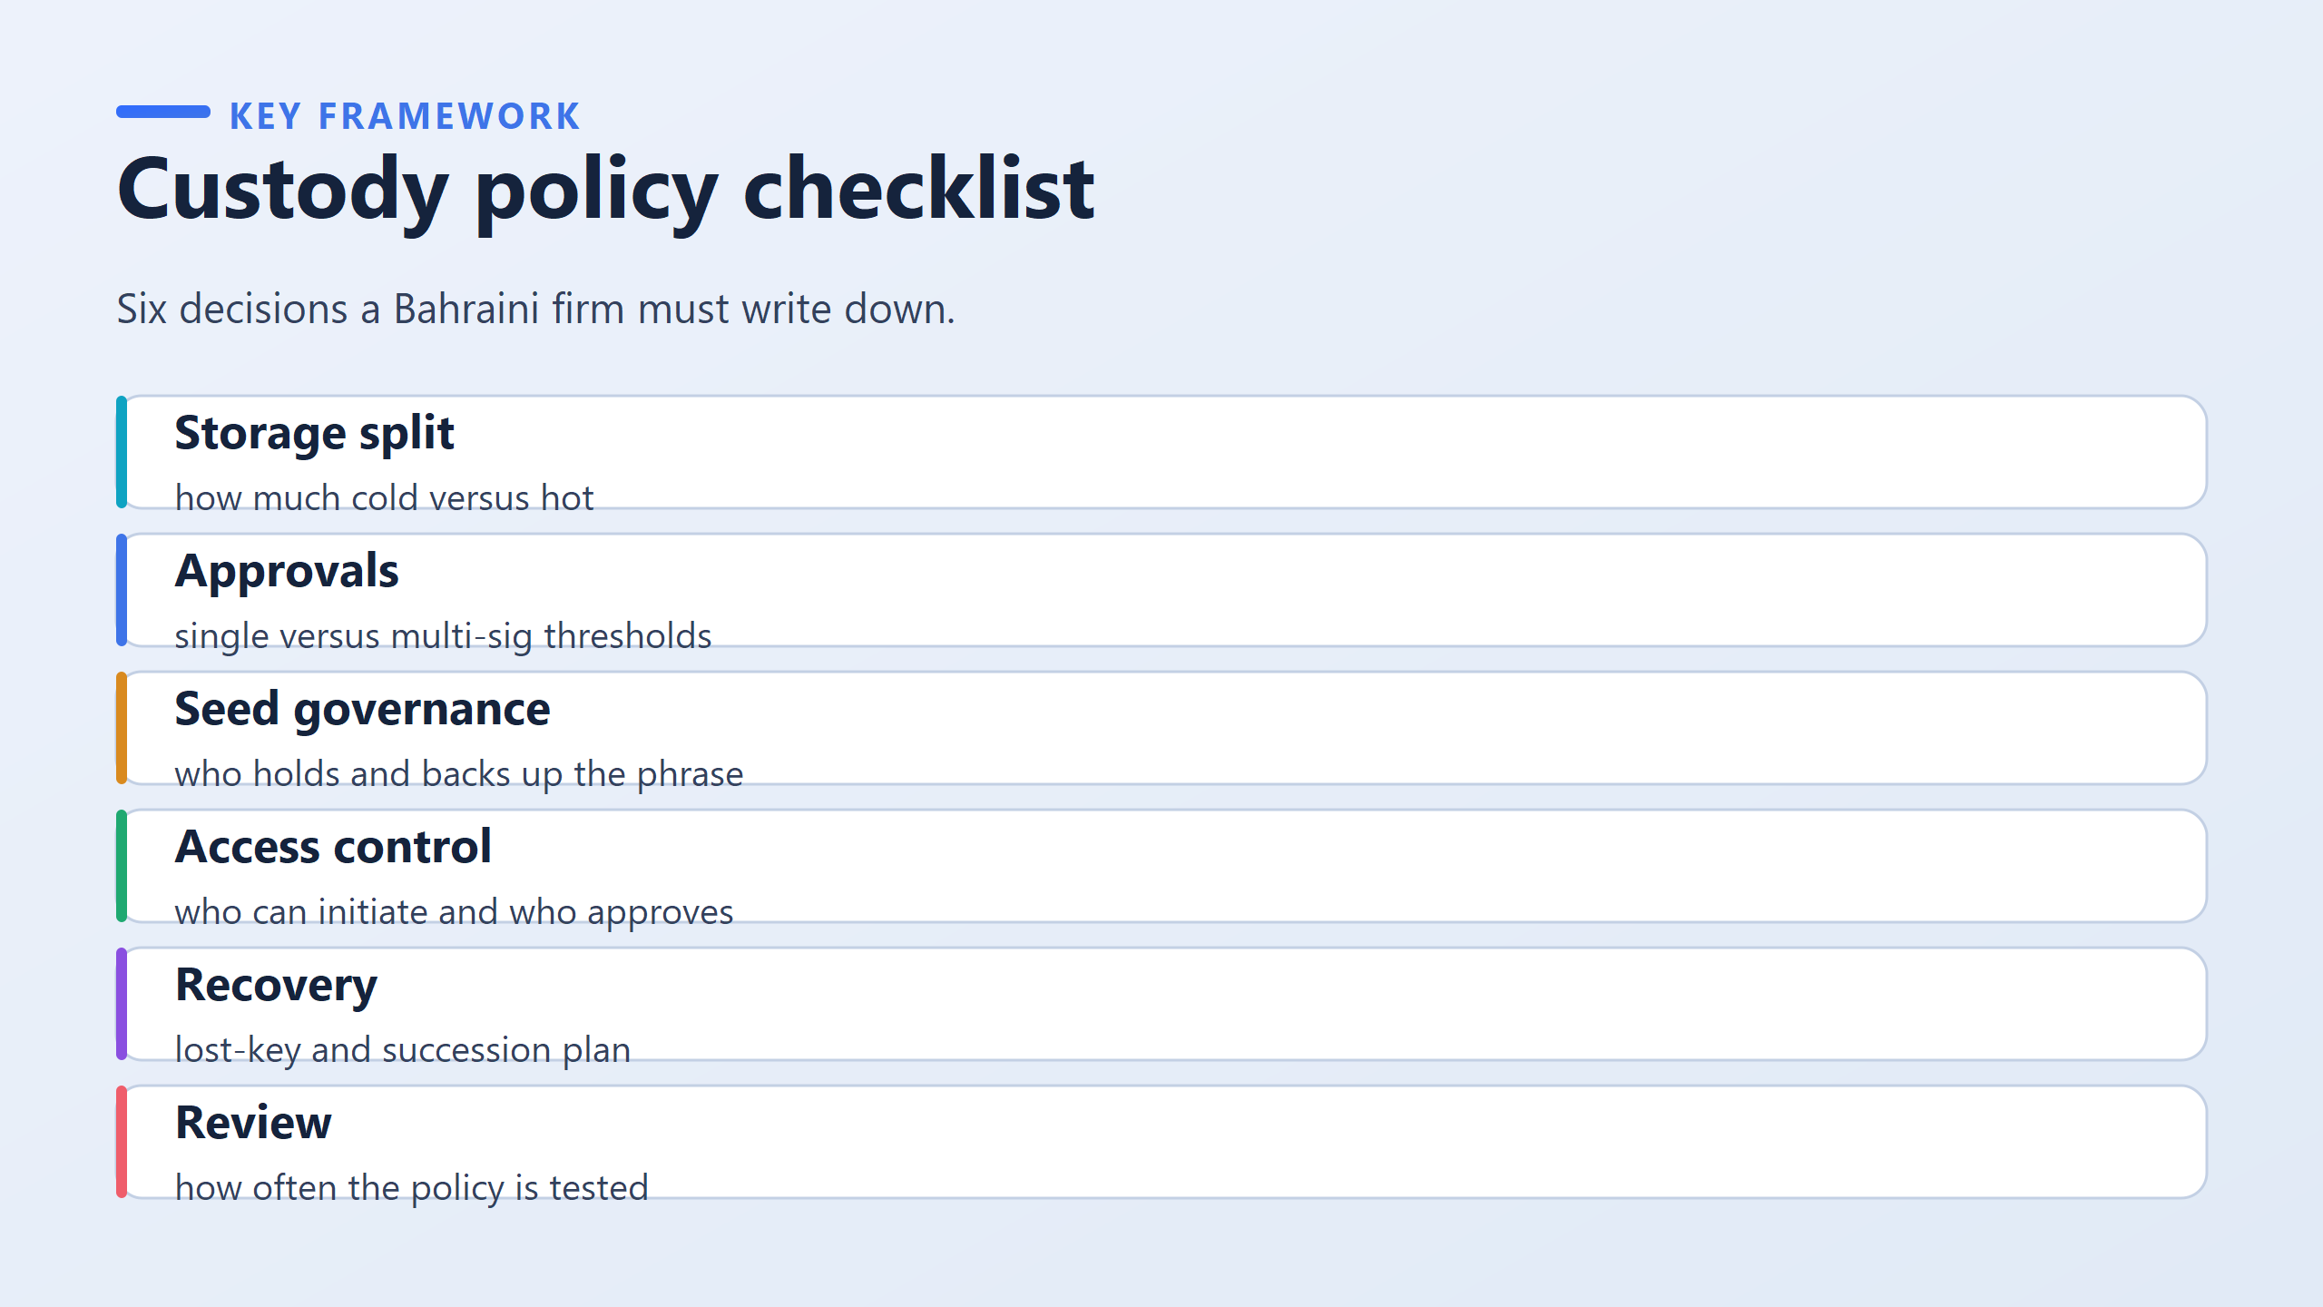
What each decision actually decides
Storage split
It decides how much is offline and slow to reach, and how much is online and usable now.
It also decides how much one breach could steal.
Example answer: "90% cold, 10% hot."
Approvals
It decides how many separate keys must sign before money moves. This is multi-signature.
A 2-of-3 threshold means any two of three named key holders are enough.
Example answer: "2-of-3: CFO, CEO, external lawyer."
Seed governance
It decides who holds the recovery words and where the backup physically sits.
This is the decision most often left blank.
Example answer: "Split into two sealed envelopes, kept in two different bank safe-deposit boxes."
Access control
It decides who can start a payment and who must approve it.
Example answer: "The accountant starts it, the CFO and CEO approve it."
Recovery
It decides what happens if a key holder resigns, dies or loses a device.
It is worthless unless it was decided before the event.
Example answer: "If a signer leaves, their key is replaced within 7 days."
Review
It decides how often the policy is tested.
Testing means actually attempting a recovery, not rereading the document.
Example answer: "Recovery drill every 6 months."

Slide 7
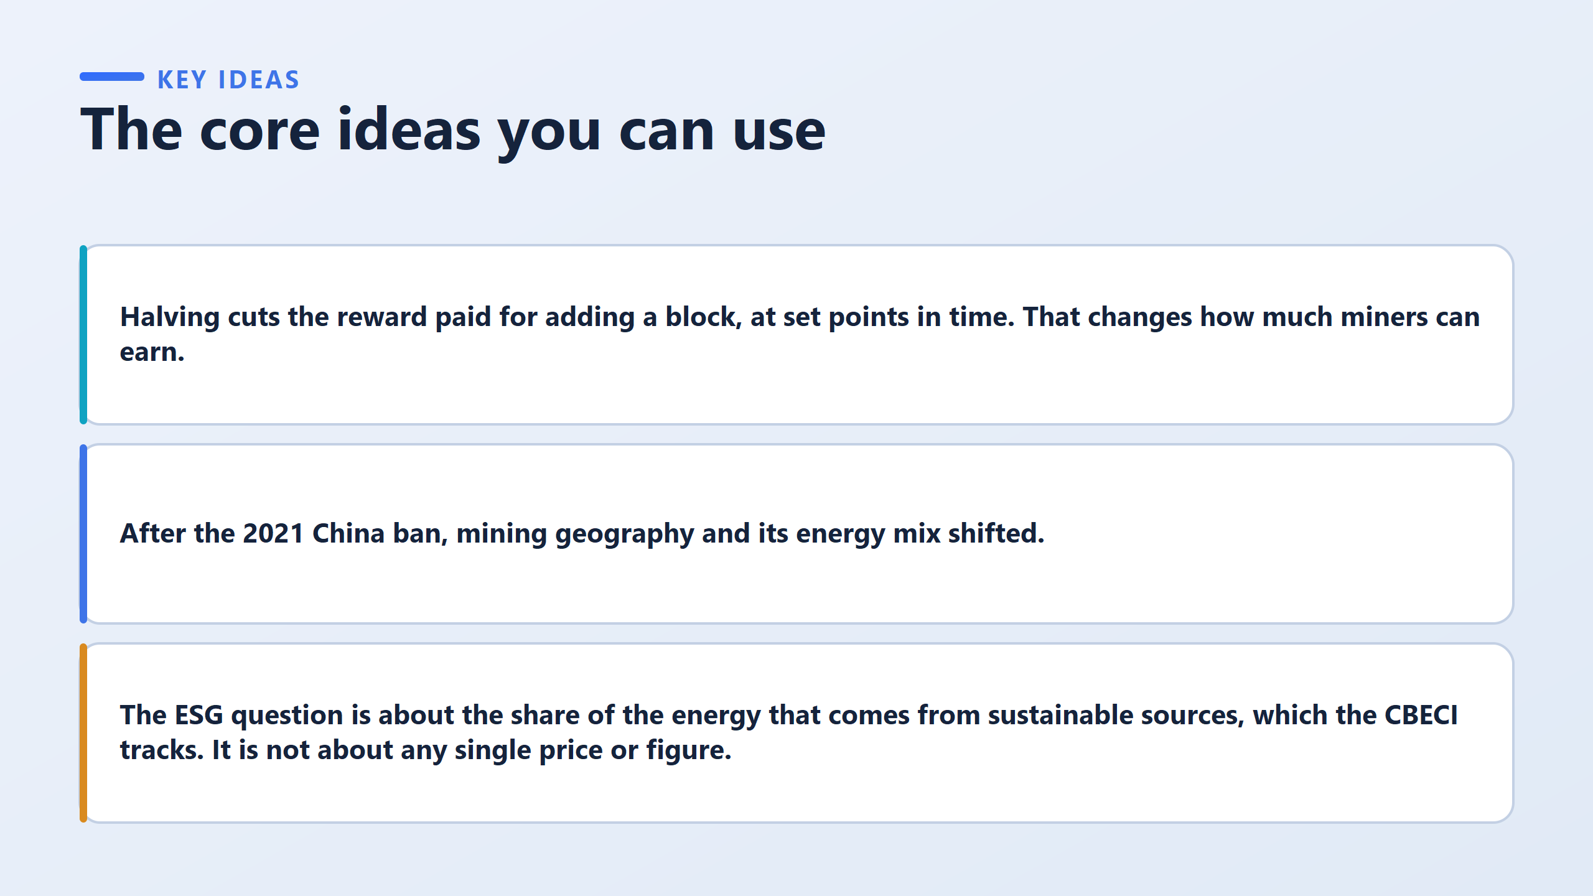

Slide 8
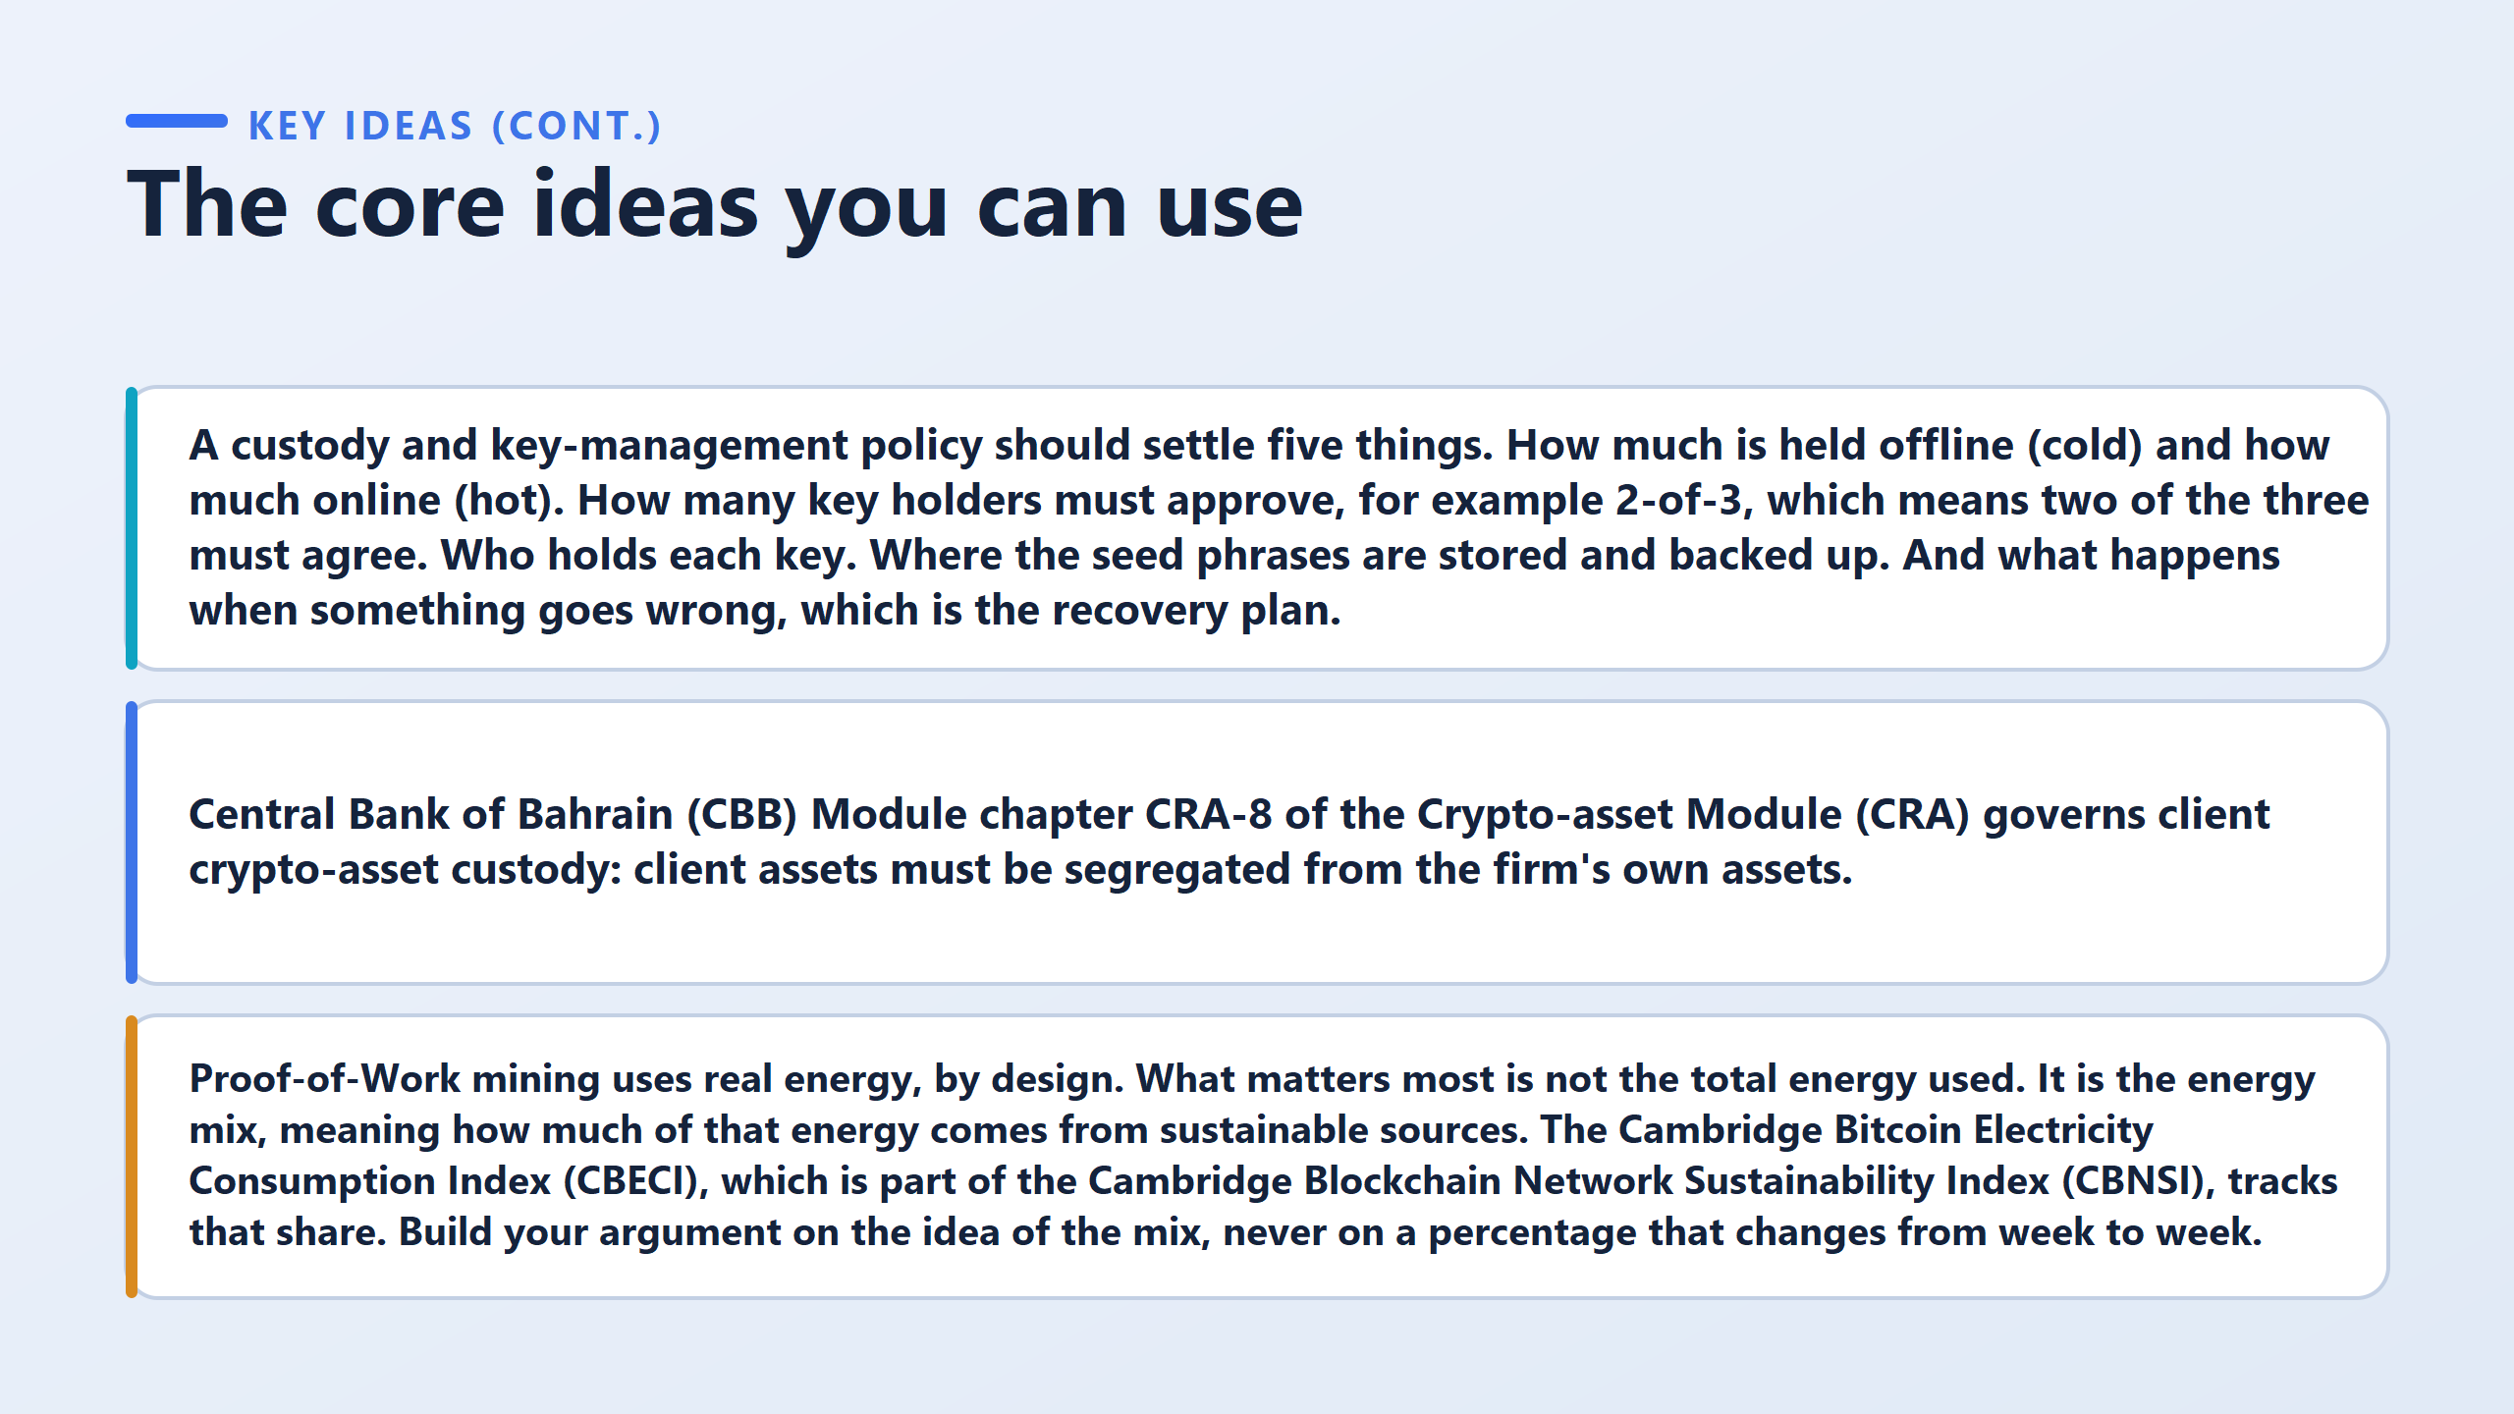

Slide 9
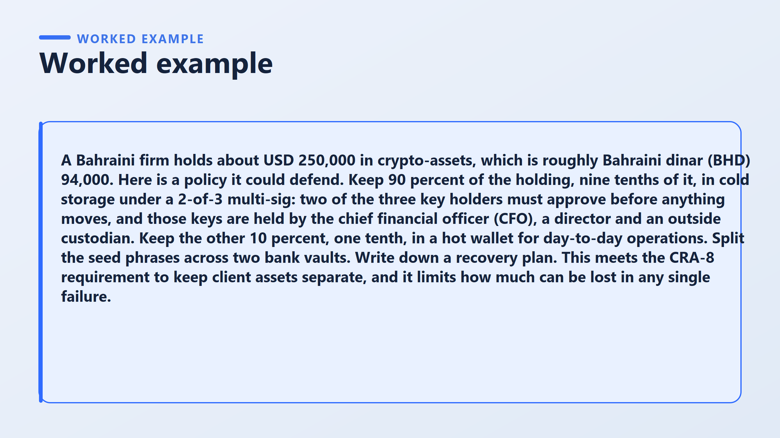

Slide 10
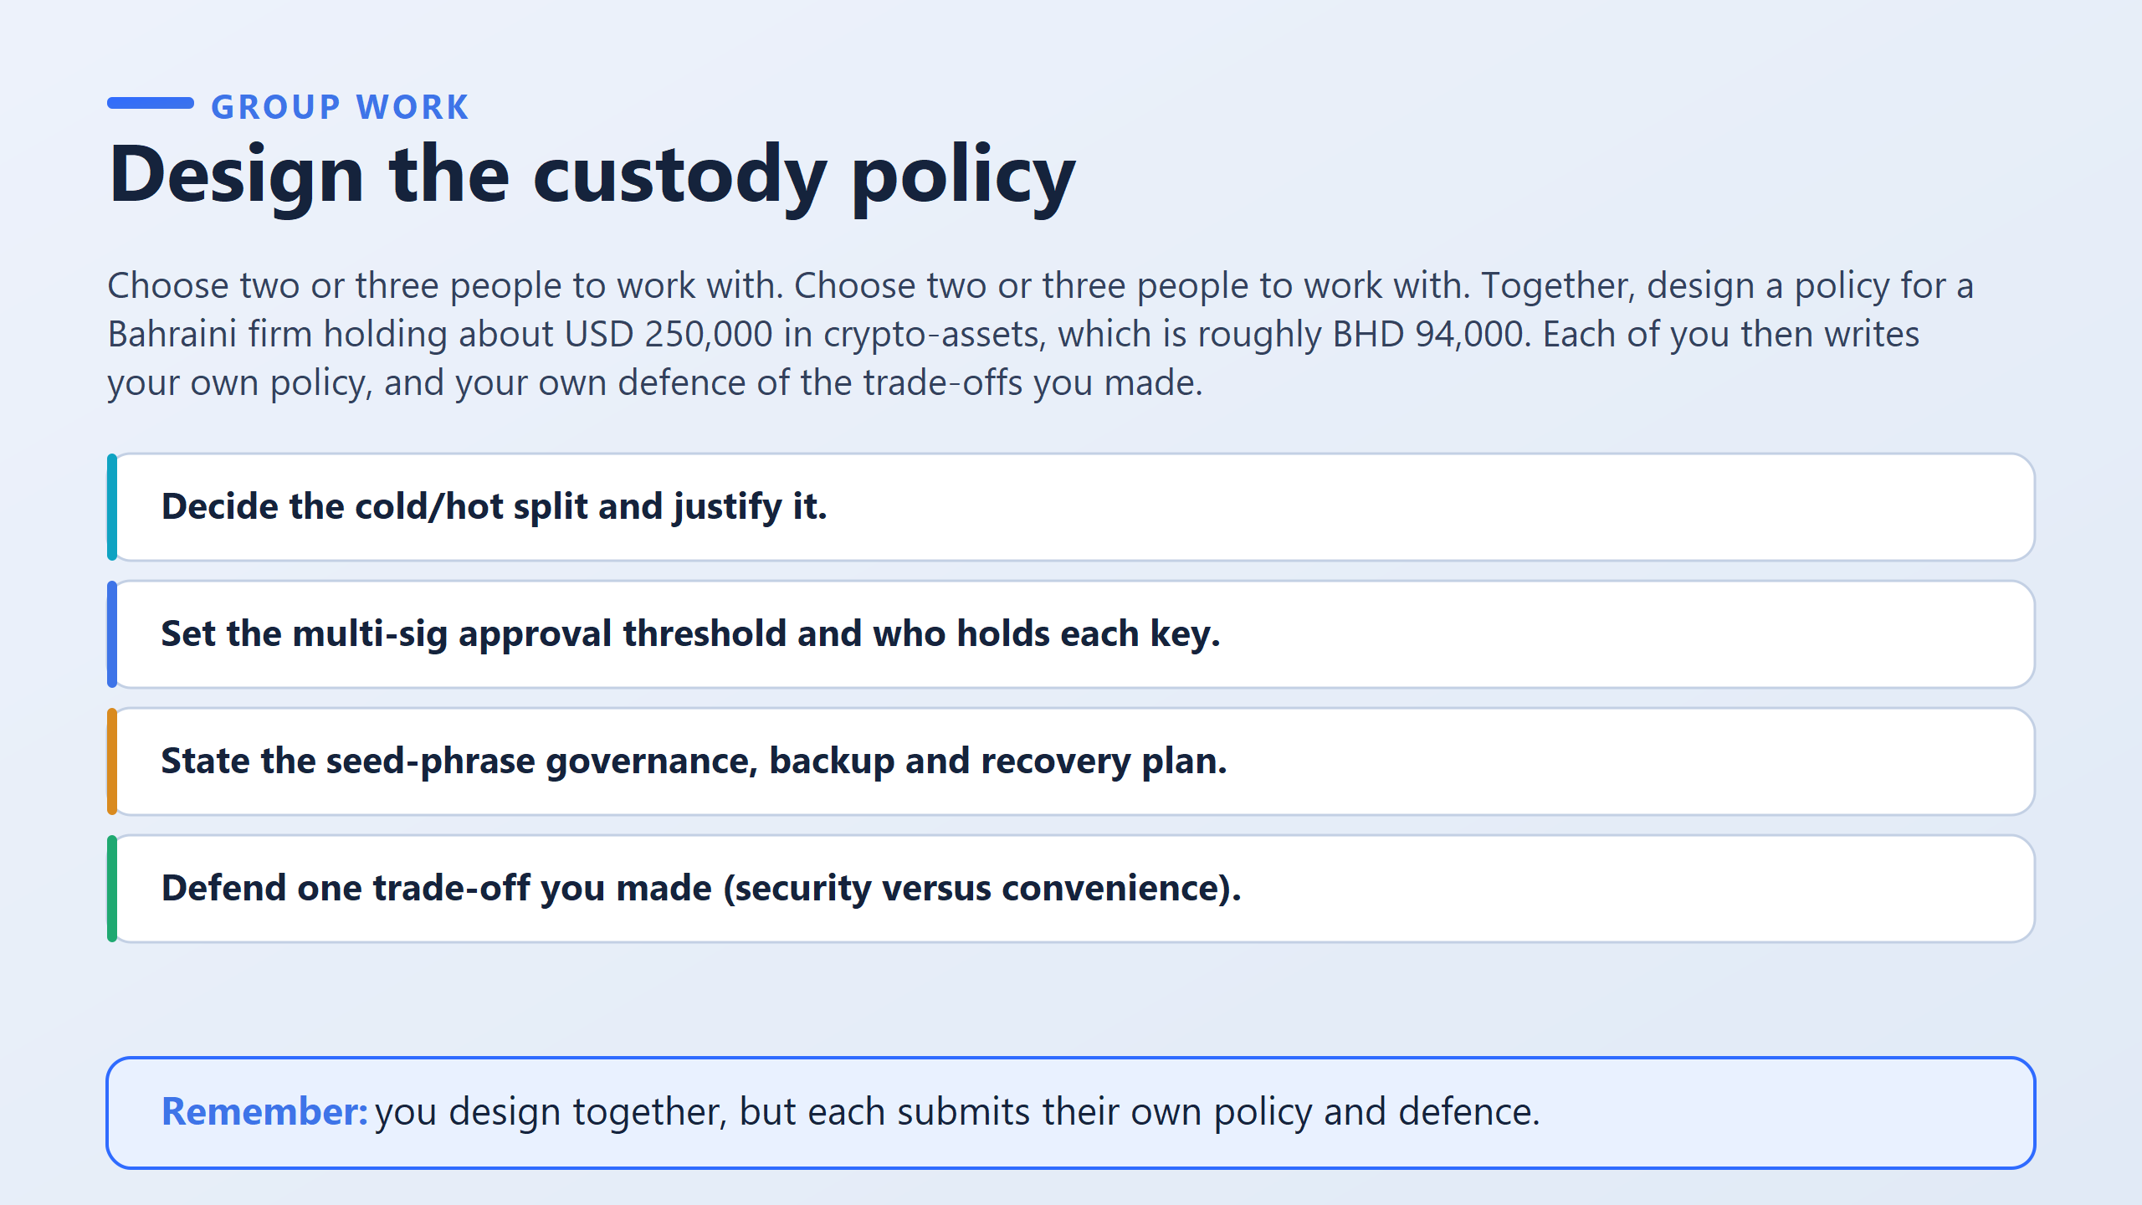

Slide 11
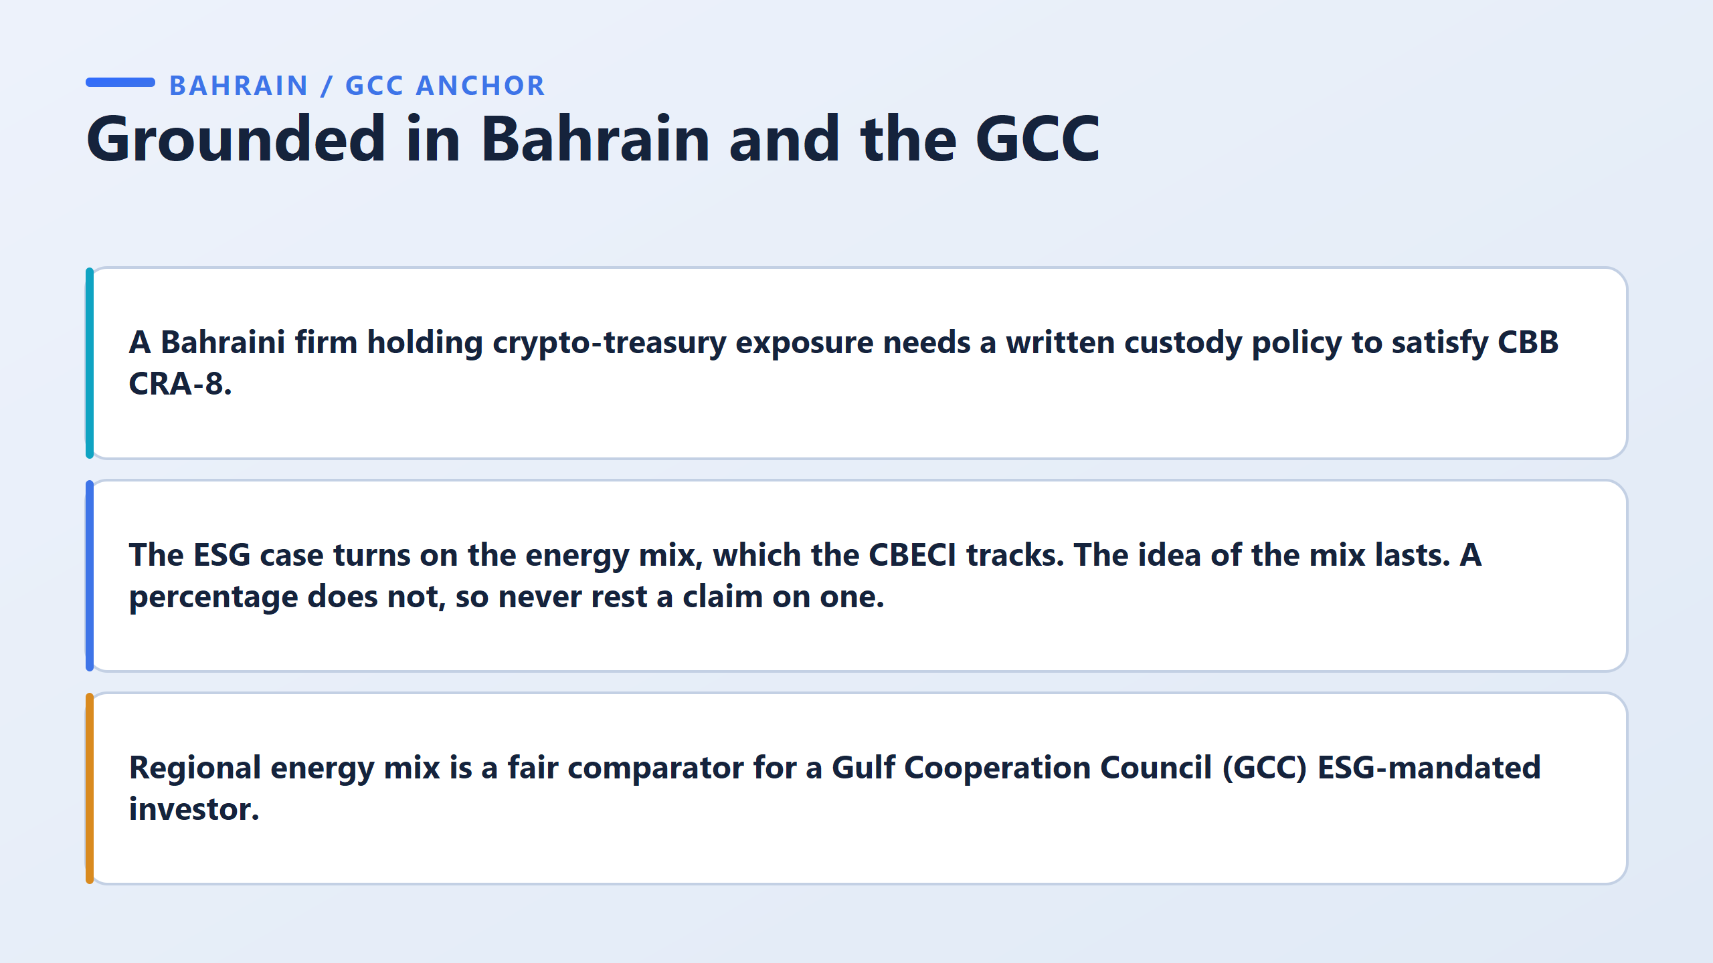

Slide 12
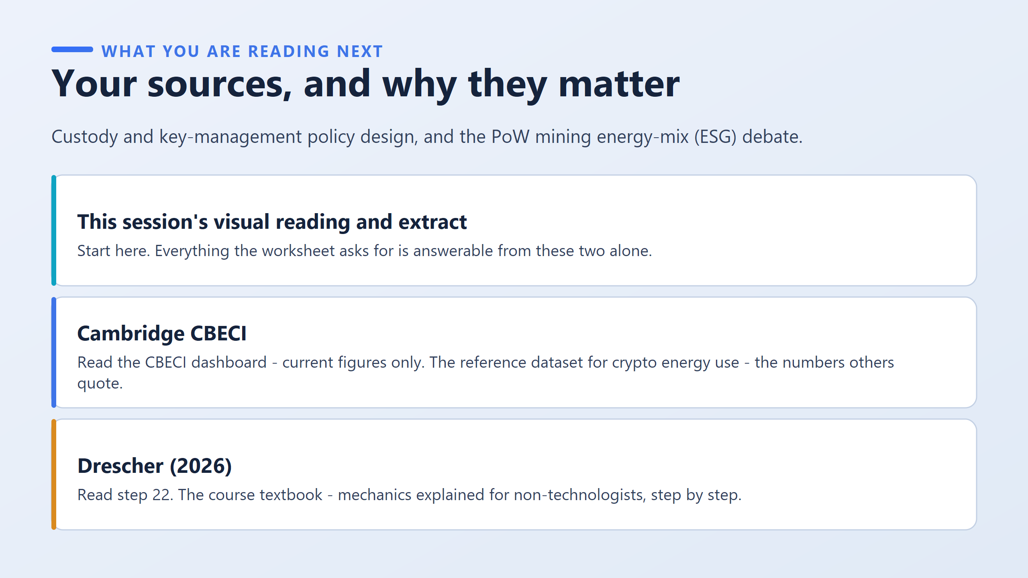

Slide 13
